Slide 1
Statistical Methods to Predict Industrial Stock Prices
Team members:
Jiahao Zhang/ Pinren Chen/ Hongjie Ren
Peilin Qiu/ Sihuai Yu/ Tangming Li/ Yufei Zhao
Yangyu Niu
Date:
April 29th (Saturday)
Instructor:
Professor Zhiliang Ying

Slide 2
Project Introduction

Slide 3

Why this project?
Stock Market ---- Highly Sophisticated Market
Traditional Scenario:
Fundamental analysis(qualitative analysis)
Basic technical indicators(MACD, Bollinger)
What We Can Do Now:
Statistical Models and Math Methods
Simulation Technology
Better Prediction
More Profits

Slide 4
Why based on industry?
Most models are designed for the whole market
Industries are inherently different in many aspects
Different models are suitable for different situations

Slide 5
A Quick Peek at the 8 Methods
C4.5 Decision Trees
Random Forest
Naive Bayes
Logistic Regression
SVM
Neural Network
Linear Discriminant Analysis

Slide 6
Basic idea:
Acquire data of 6 industries from Bloomberg Terminals and initially choose 47 indexes, including micro indexes and macro indexes
Apply seven classification statistical models(machine learning algorithm)
Predict the 3-month returns on 2017.3.31 using the quarterly data from 2009.3.31 to 2016.12.31
Acquire the real 3-month returns from Bloomberg Terminals and compare the predicted value we calculated with these real values

Slide 7
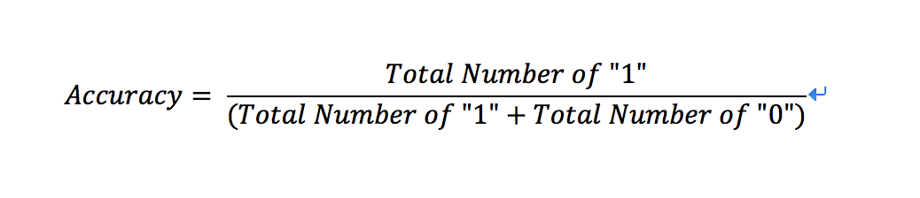
Definition of Accuracy
If return is greater than or equal to 10%, denote as “Good”
Otherwise, denote as “Bad”
If predicted class is the same as true class, denote as “1”
Otherwise, denote as “0”
Define “ Accuracy ” as follows:

Slide 8
How we choose the data
Micro Indexes:
Tangible book value per share,
current market capitalization,
change of net income,
dividend yield, earnings per share,
net revenue, sales growth,
price to earnings ratio,
current ratio, book value per share, asset turnover, net revenue growth, currency ratio, PE ratio...
Macro Indexes:
Velocity of M1,
Velocity of M2,
Gross Domestic Product Index,
Consumer Price Index,
US Trade Balance of Goods and Services,
Amount of import and export,
Unemployment rate
Personal Consumption Expenditure...

Slide 9
Statistical Model Introduction

Slide 10
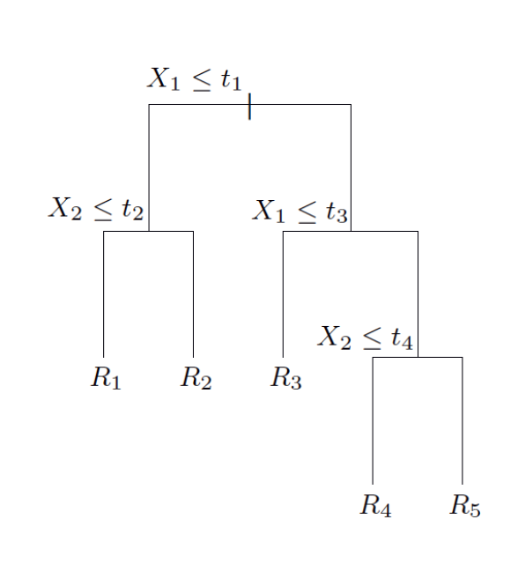
C4.5 Decision Trees
A decision tree is a decision support tool that uses a tree-like graph or model of decisions and their possible consequences, including chance event outcomes, resource costs, and utility.
Commonly used in operations research and operations management.

Slide 11
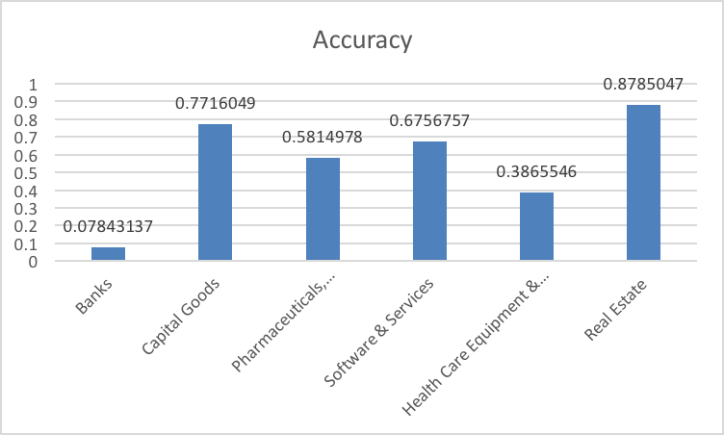
C4.5 Decision Trees
Advantages:
Able to handle both numerical and categorical data
Performs well with large datasets
Disadvantages:
Trees can be very non-robust
Decision trees is biased in favor of attributes with more levels

Slide 12
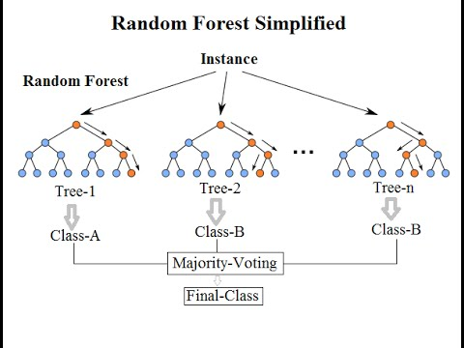
Random Forest
Fit a decision tree to different Bootstrap samples
Select a random sample of m<p predictors to consider in each step when growing each tree
This will lead to uncorrelated trees for each sample
Grow 500 trees in total
Finally, average the prediction of each tree

Slide 13
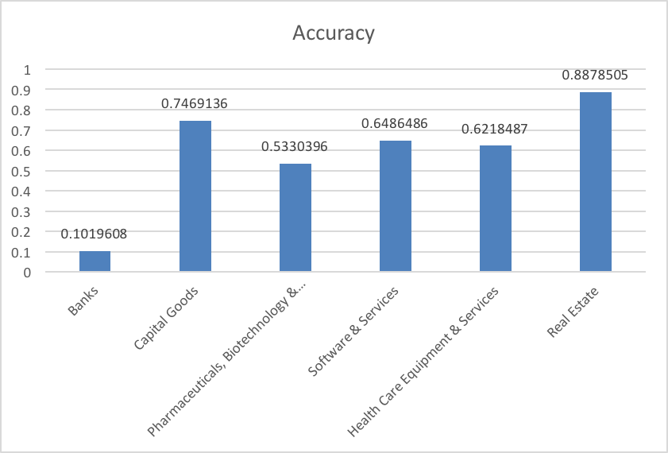
Random Forest
Advantages:
Improve accuracy if 50% of the data are classified correctly in each tree
Disadvantages:
Computationally intensive
Overfitting Risk

Slide 14
Naive Bayes
In machine learning, Naive Bayes classifiers are a family of simple probabilistic classifiers based on applying Bayes’s theorem.
Main Assumption:
Features are independent with each other

Slide 15
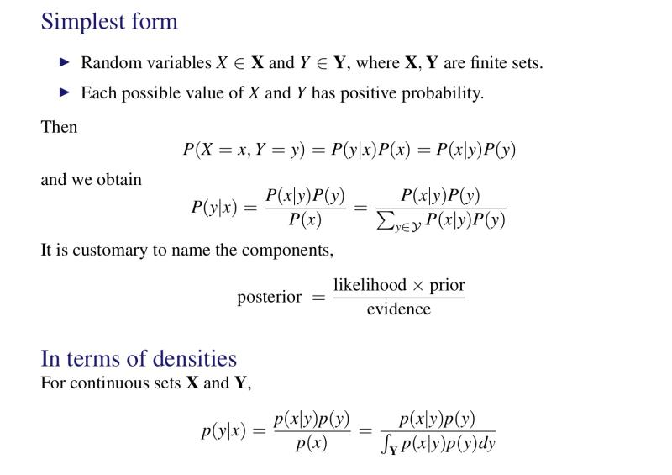

Slide 16
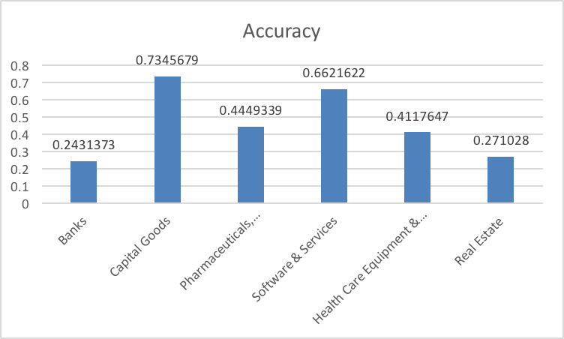
Naive Bayes
Advantages:
Computing very fast
Disadvantage:
Response has to be categorical
Independent Features Required

Slide 17
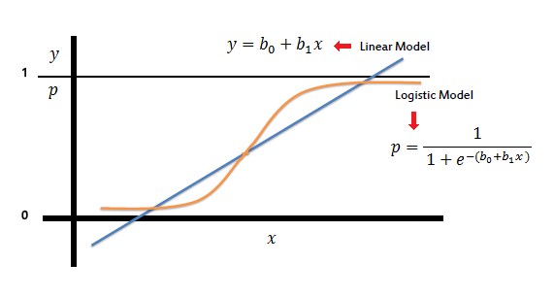
Logistic Regression
Logistic regression is a statistical method for analyzing a dataset in which there are one or more independent variables that determine an outcome. The outcome is measured with a dichotomous variable.
Mainly used in medical and pharmaceutical area

Slide 18
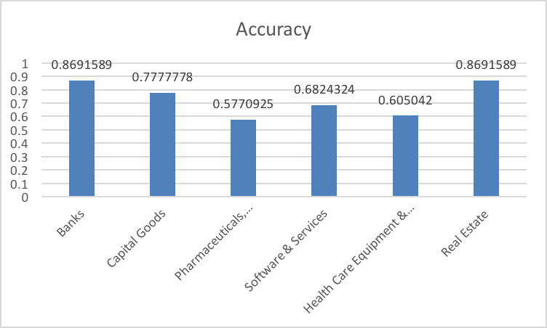
Logistic Regression
Advantages:
Easy to implement
Variables can be either categorical or continuous
Disadvantages:
Multicollinearity risk
Limited Outcome Variables
Demand Independent variables

Slide 19
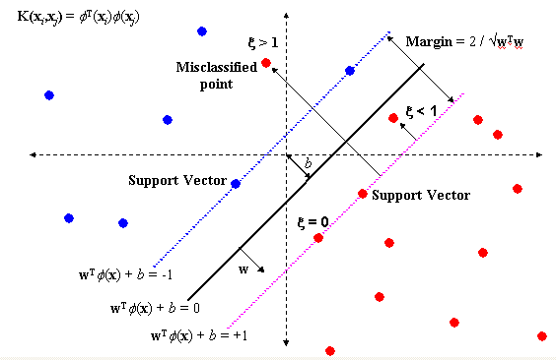
Support Vector machine
A Support Vector Machine (SVM) is a discriminative classifier formally defined by a separating hyperplane. In other words, given labeled training data (supervised learning), the algorithm outputs an optimal hyperplane which categorizes new examples.

Slide 20
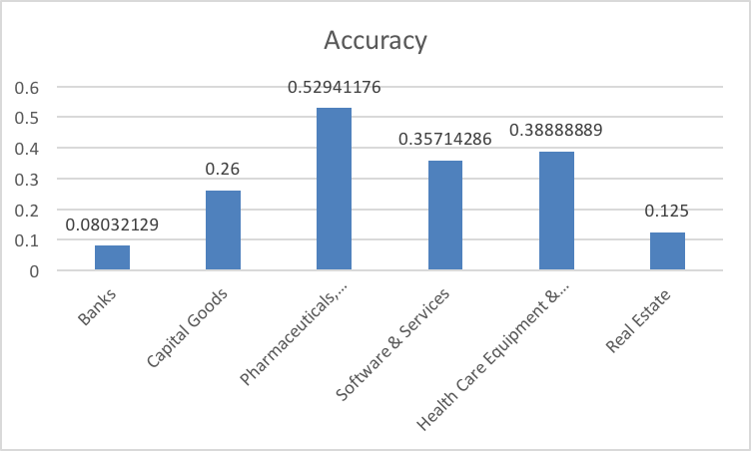
Support vector machine
Advantage:
provide a good out-of-sample generalization
With the choice of an appropriate kernel, one can put more stress on the similarity between companies
Disadvantage:
SVMs cannot represent the score of all companies as a simple parametric function

Slide 21
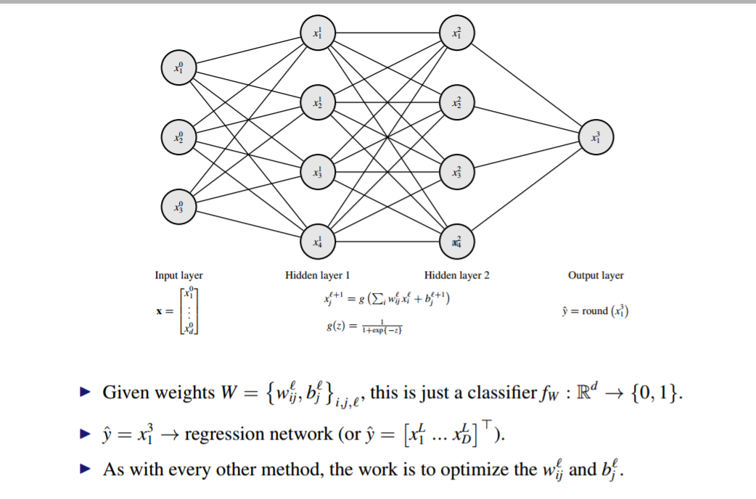
Neural Network

Slide 22
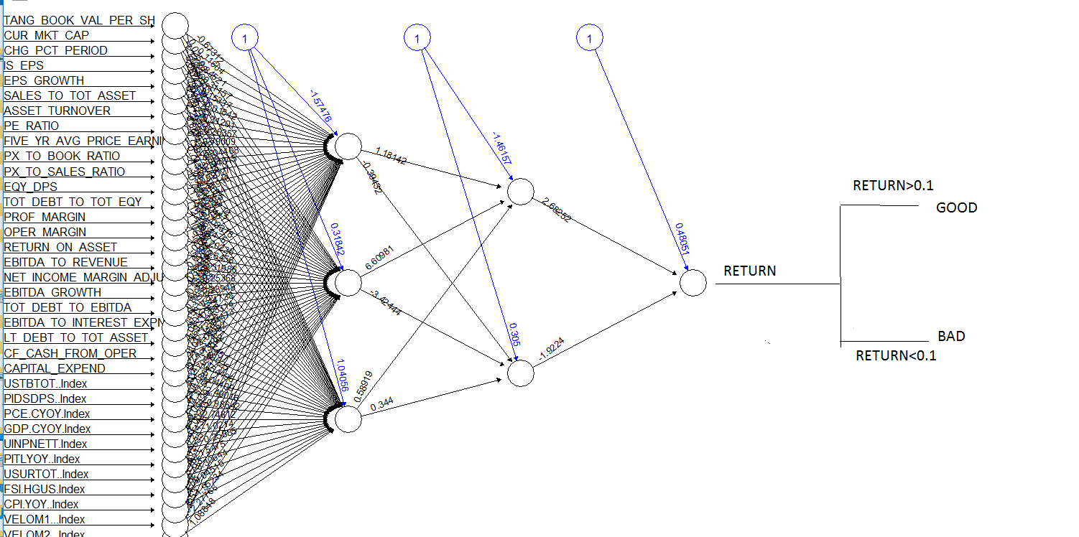
Neural Network

Slide 23
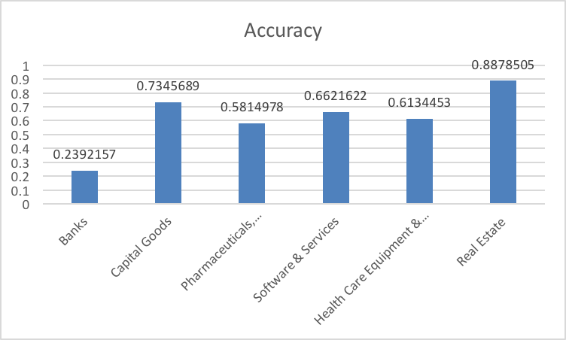
Neural Network
Advantage:
Dynamic Non-Linear System
A good model for the dynamic stock market
Disadvantage:
Computational Complex
Low Efficient

Slide 24
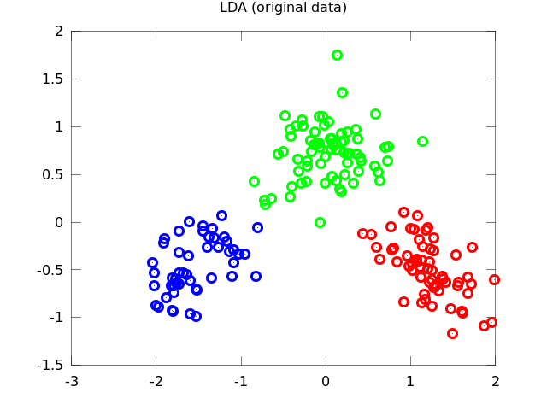
Linear Discriminant Analysis
Linear discriminant analysis(LDA) is a generalization of Fisher’s Linear Discriminant, a method used in Statistics, Pattern Recognition and Machine Learning.
Two assumptions:
Gaussian distributed classes
Equal class covariance.

Slide 25
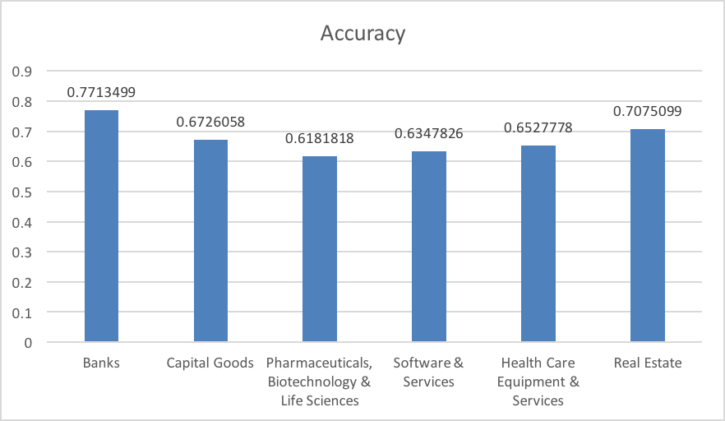
Linear Discriminant Analysis
Advantage:
Performs better with small samples with many variables
Disadvantage
Not flexible (Linear boundaries only)

Slide 26
Results Analysis

Slide 27
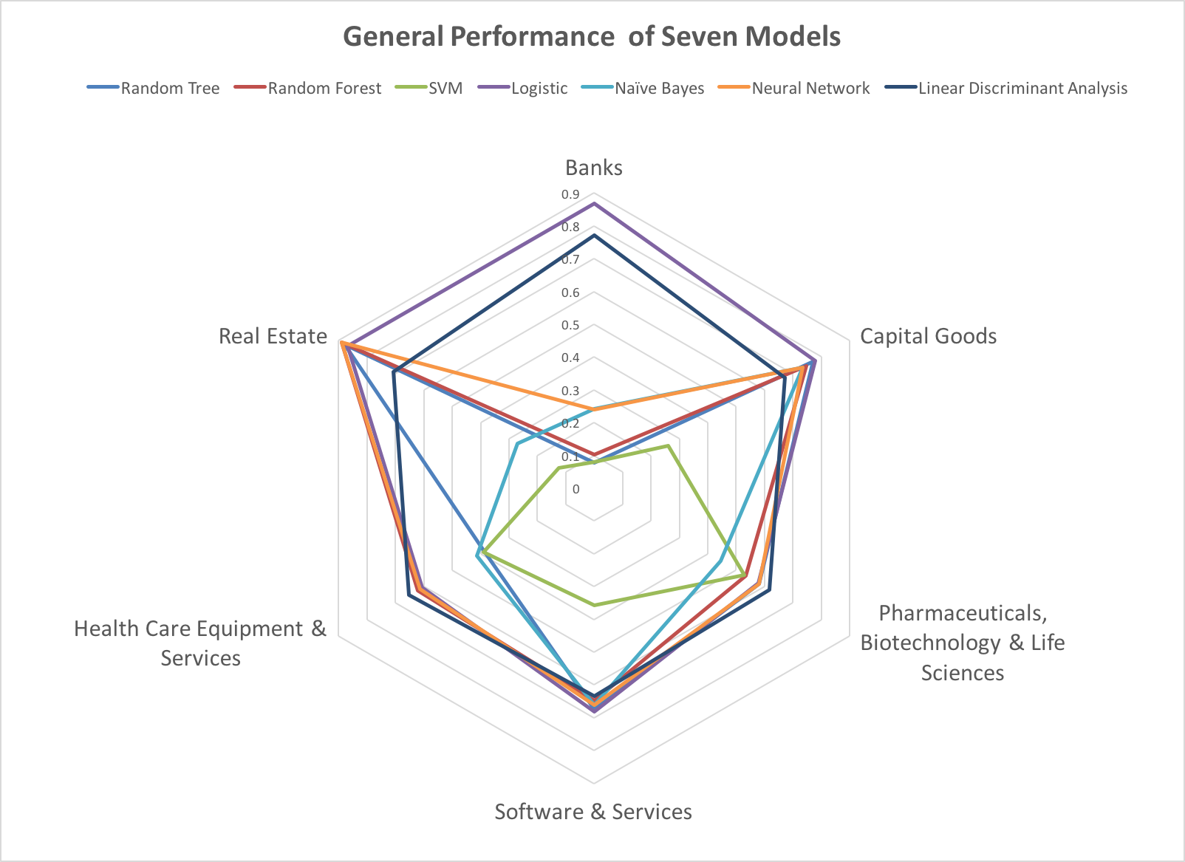

Slide 28
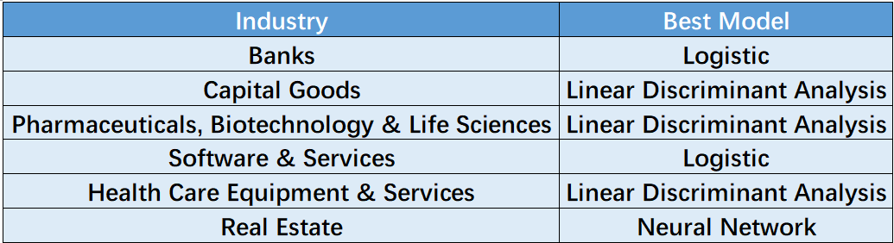
Conclusion

Slide 29

Moving On
Mixture model analysis-- Adaboost
Consider inter-industrial impacts
Consider international market impacts
Consider political factors (text mining)
More and more!!

Slide 30
Thank you!
Q & A

